Slide 1
Spring Bean
Compiler: Lê Anh Vũ
Email: levu@yahoo-corp.jp

Slide 2
Agenda
Bean Definition
Bean Scope
Get Bean
Bean Lifecycle
Component

Slide 3
Bean Definition
Spring Bean is the object in the Spring framework
Instantiated through the Spring container
Configure Bean with Java code using annotations:
org.springframework.context.annotation.Bean: annotation on method
org.springframework.context.annotation.Configuration: annotation on class

Slide 4
Bean Scope
6 bean scope:
singleton
prototype
request
session
application
Websocket
Annotation: org.springframework.context.annotation.Scope

Slide 5
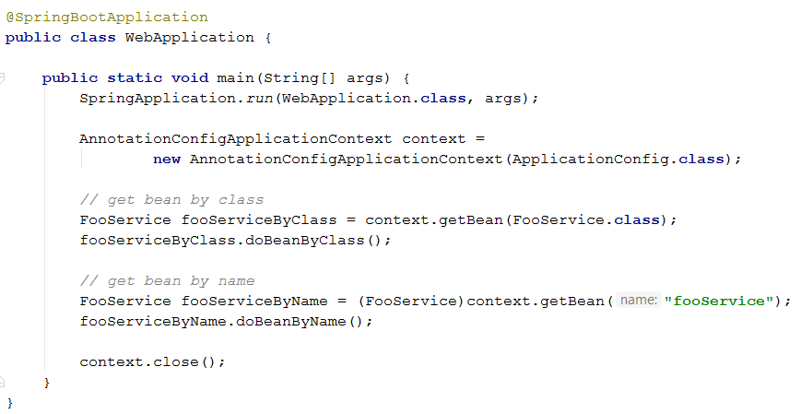
Get Bean
The most common is:
Get bean by name
Get bean by class:

Slide 6
Bean Lifecycle
2 types of lifecycle callback :
Initialization method
Destruction method:
3 ways to define lifecycle callback:
initMethod & destroyMethod
@PostConstruct & @PreDestroy
Implement 2 interface InitializingBean & DisposableBean then override method afterPropertiesSet() & destroy()

Slide 7
Component
Component is the most frequently beans
4 stereotype annotation:
@Component
@Controller
@RestController
@Service
@Repository

